Slide 1
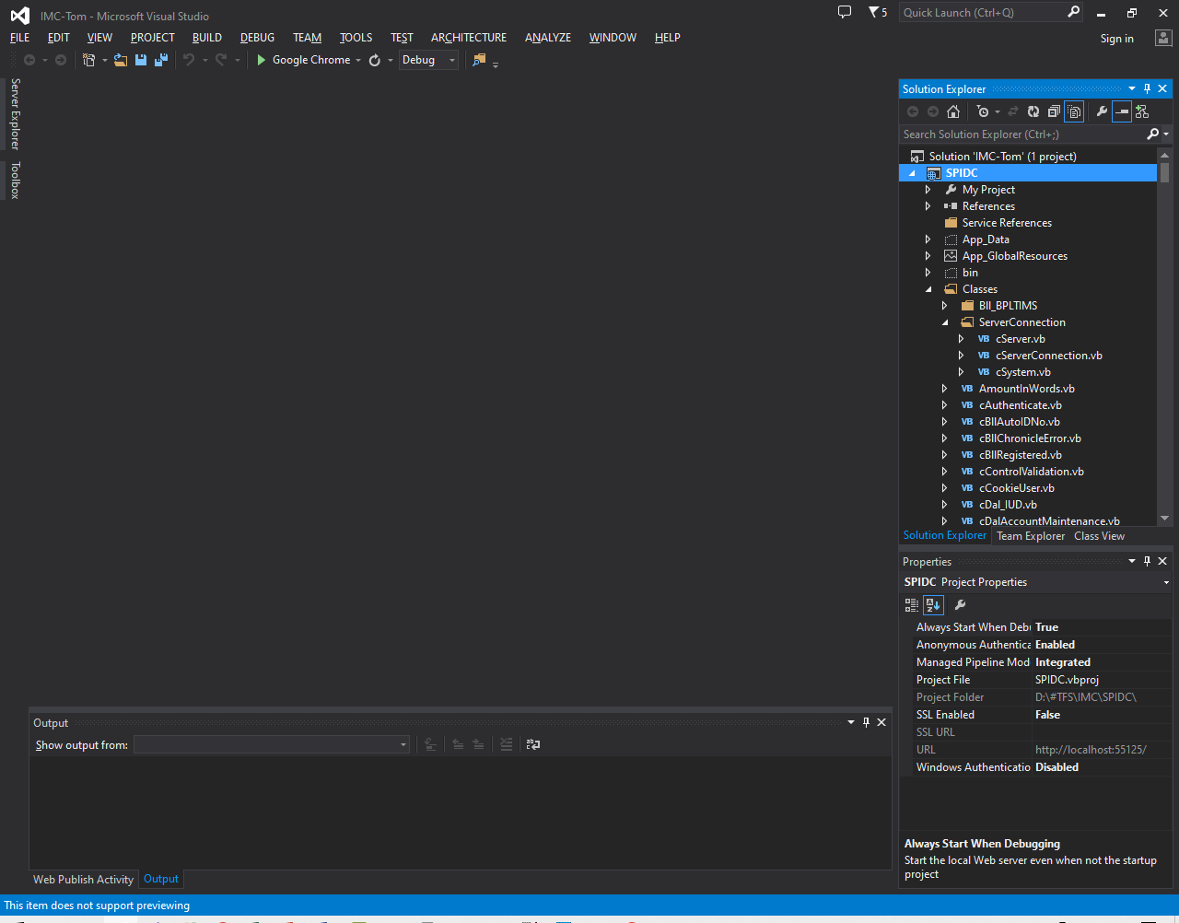
HOW TO PUBLISH
1. OPEN THE WEB PROJECT

Slide 2
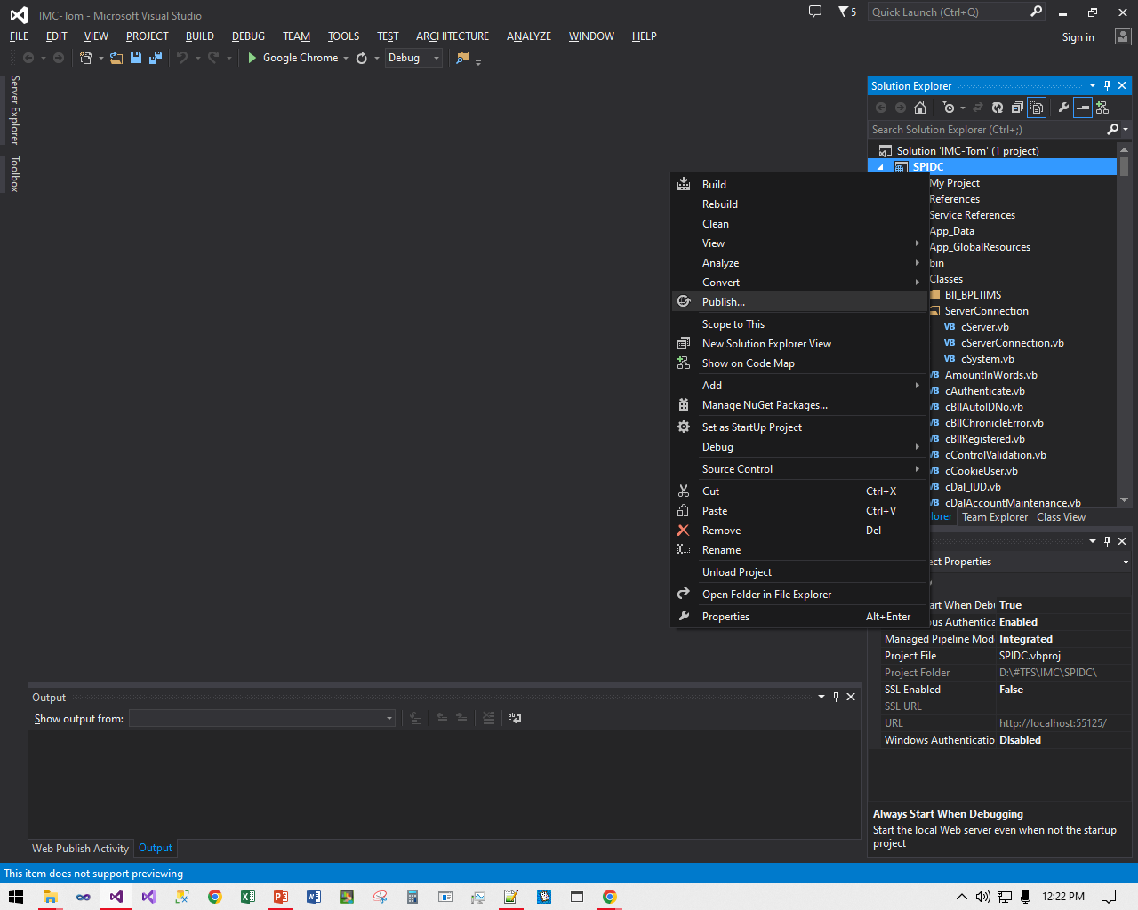
2. RIGHT CLICK THE PROJECT
AND CLICK PUBLISH

Slide 3
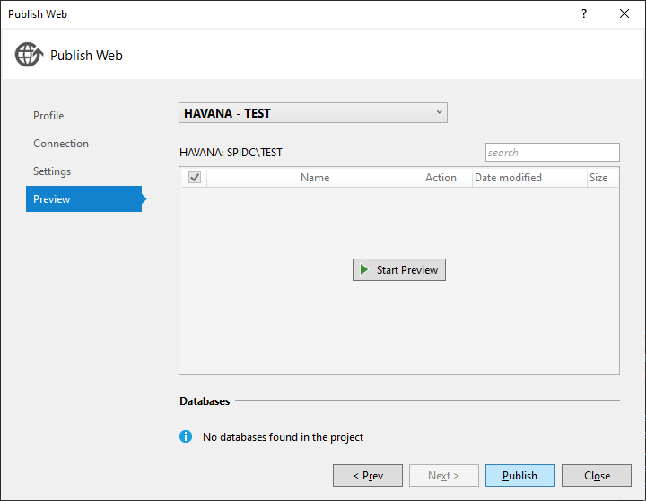
3. CLICK PUBLISH

Slide 4
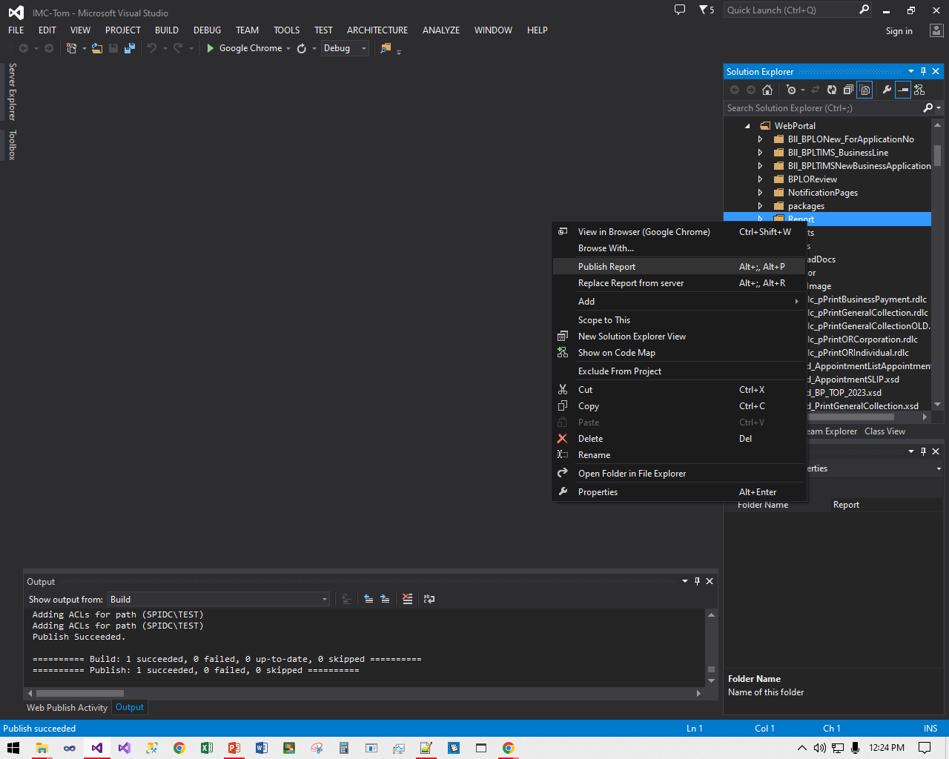
4. WAIT FOR THE PUBLICATION TO FINISH
DO THE SAME FOR REPORTS FOLDER IF YOU MADE CHANGES TO THE REPORT OR FOR NEW PUBLISH

Slide 5
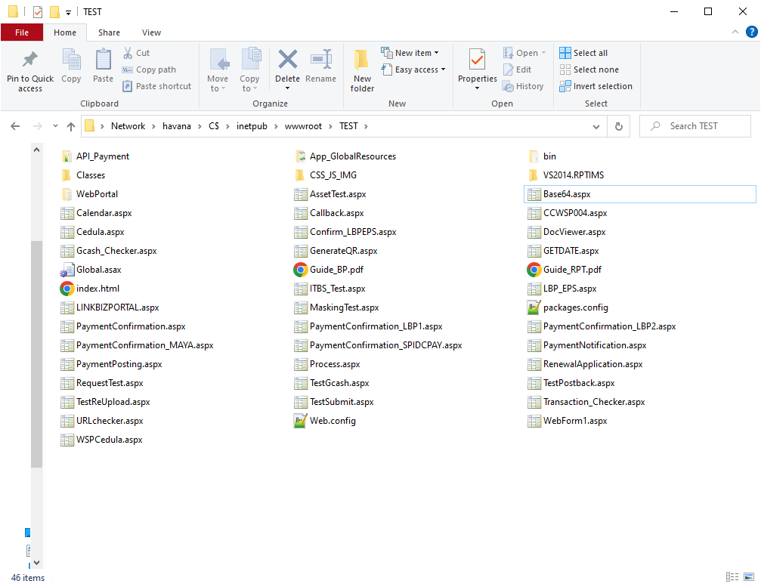
5. PUBLISHED FILES CAN BE SEEN HERE
\\havana\C$\inetpub\wwwroot\TEST

Slide 6
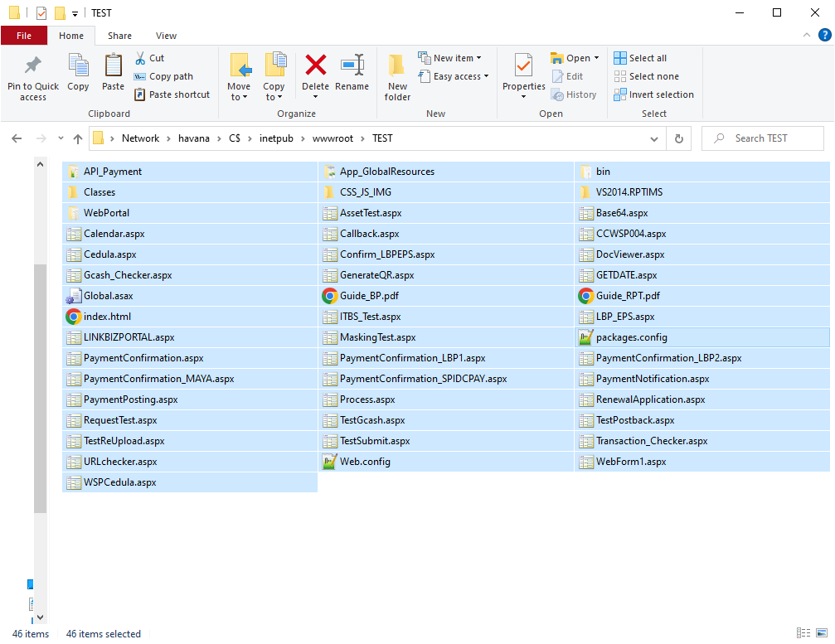
6. COPY THESE FILES FROM C$\inetpub\wwwroot\
AND PASTE IT ON THE WEBSERVER(LGU) PATH

Slide 7
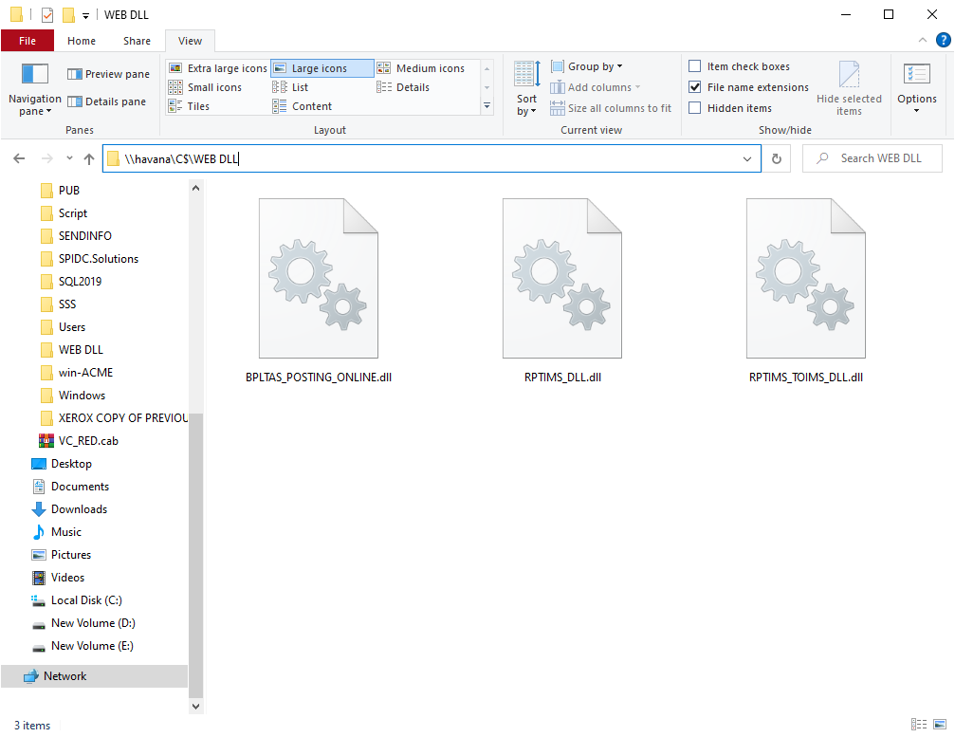
7. COPY THESE DLL FROM \\havana\C$\WEB DLL
AND PASTE IT ON WEBSERVER(LGU) PATH
C:\WEB DLL
(IF FOLDER DOES NOT EXISTS, CREATE ONE)

Slide 8
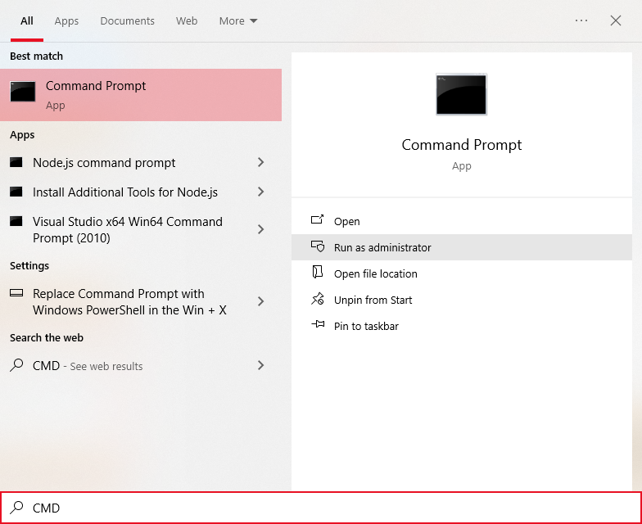
8. REGISTER EACH DLL ON WEBSERVER
REMOTE THE WEBSERVER(LGU)
RUN CMD AS ADMINISTRATOR

Slide 9
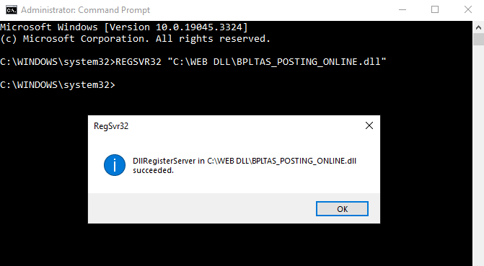
9. REGISTER EACH DLL ON WEBSERVER
TYPE
REGSVR32 “DLL PATH HERE”
AND PRESS ENTER, DO THE SAME FOR ALL DLL

